Slide 1
DIVERSITY & INCLUSION
CE 4200
PROFESSIONAL ENGINEERING PRACTICE ISSUES
WILLIAM D. LAWSON, PE, PHD
Fall 2021 SEMESTER

Slide 2
CONTEXT… BOK3E
CIVIL ENGINEERING LEADERSHIP Professional Engineering Practice Issues

Slide 3

BOK3E Outcomes
Mathematics
Natural Sciences
Social Sciences
Humanities
Materials Science
Engineering Mechanics
Experimental Methods and Data Analysis
Critical Thinking and Problem Solving
Project Management
Engineering Economics
Risk and Uncertainty
Breadth in Civil Engr Areas
Design
Technical Depth
Sustainability
Communication
Teamwork and Leadership
Professional Attitudes
Lifelong Learning
Ethical Responsibility
Professional Responsibilities

Slide 4
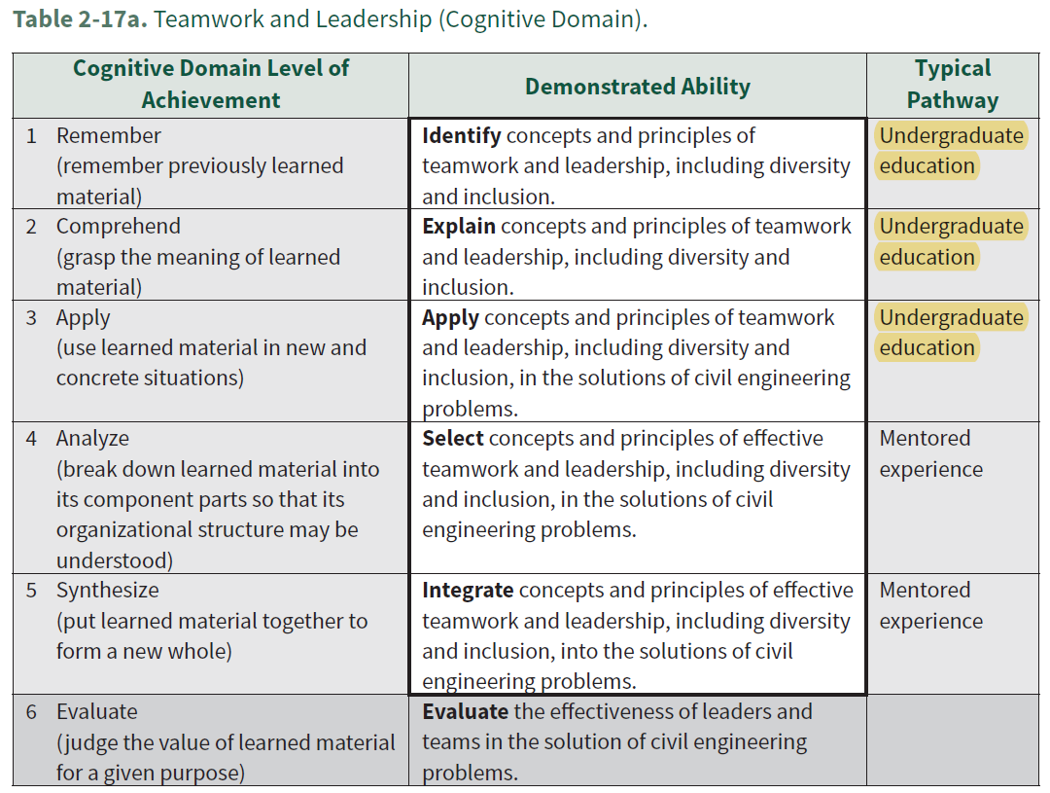

Slide 5
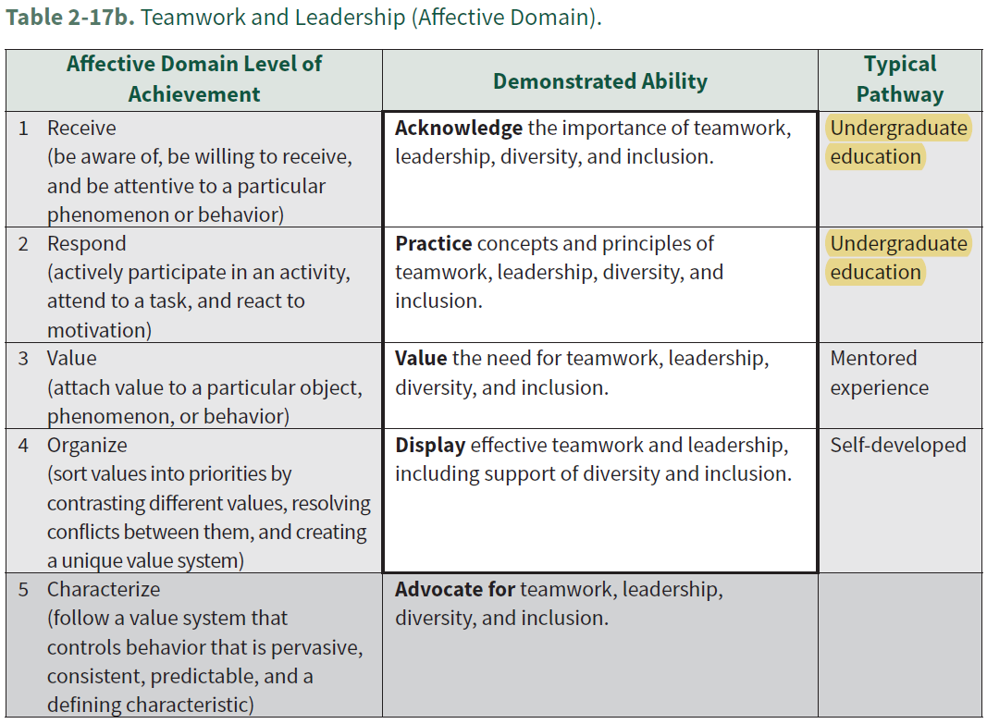

Slide 6
Understanding the Outcome
“A team composed of diverse individuals, e.g. race, ethnicity, gender, engineering discipline, or non-engineer, leads to better creativity and more diligence and hard work in the entire team.”

Slide 7
CLASS EXERCISE
CIVIL ENGINEERING LEADERSHIP Professional Engineering Practice Issues

Slide 8
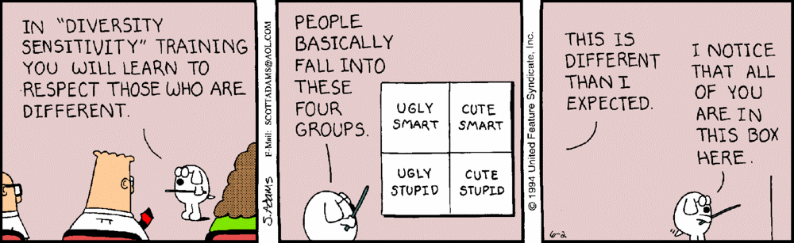

Slide 9
di·ver·si·ty
: the condition of having or being composed of differing elements : VARIETY
especially : the inclusion of different types of people (such as people of different races or cultures) in a group or organization
Synonyms: contrast, difference, dissimilarity, distance, distinctiveness, otherness
Antonyms: alikeness, community, likeness, resemblance, sameness, similarity

Slide 10
CLASS EXERCISE
BOK claims diversity and inclusion leads to:
better creativity
more diligence
hard[er] work in the entire team
Successful examples/ illustrations…
Practices that did not work so well…
3. Questions you have about diversity and inclusion…

Slide 11
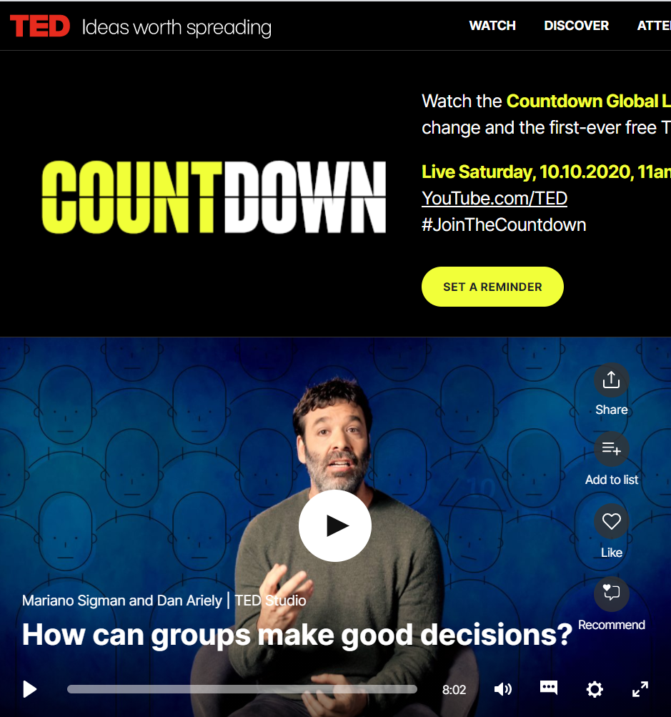
Consider a practical application

Slide 12
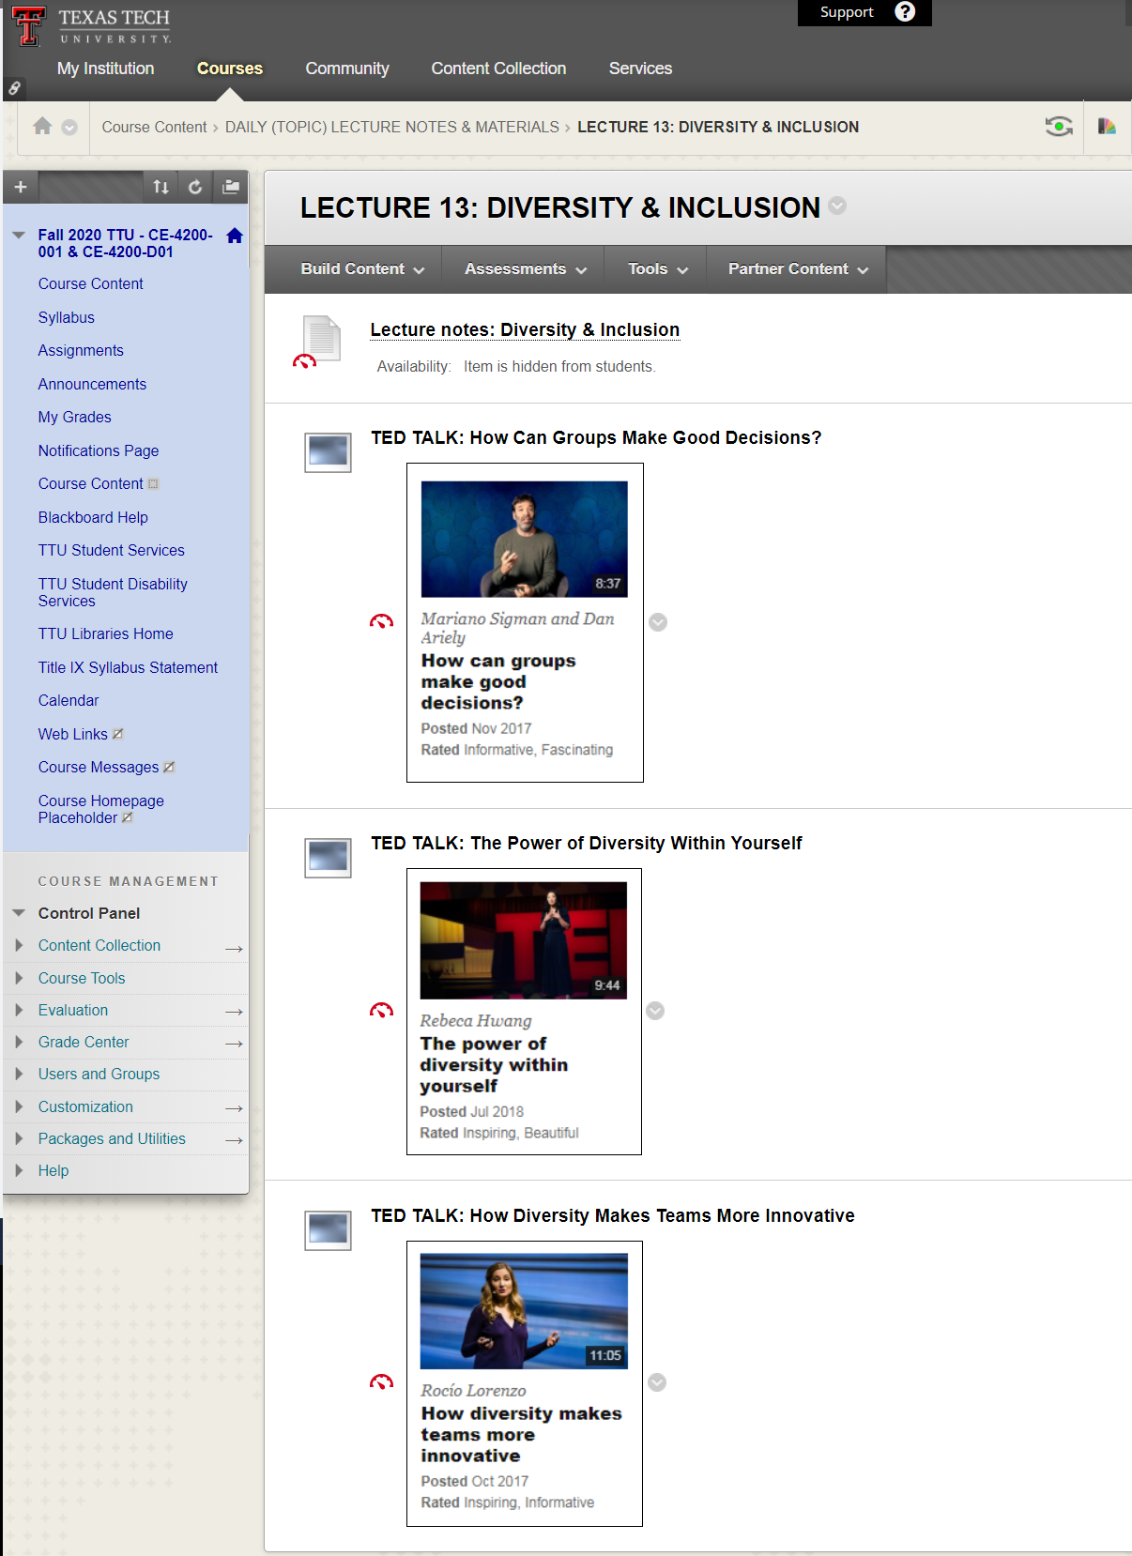
On the course website

Slide 13
OBSERVATIONS FROM BUSINESS
CIVIL ENGINEERING LEADERSHIP Professional Engineering Practice Issues

Slide 14

Diversity And Inclusion Matters To The Workforce Of The Future FORBES Human Resources Council
“The idea of diversity and inclusion has permeated the world of business. Everyone seems to be talking about it in the context of establishing a society where traditionally underrepresented groups get their fair share of opportunities….”
SOURCE: https://www.forbes.com/sites/forbeshumanresourcescouncil/2018/05/09/diversity-and-inclusion-matters-to-the-workforce-of-the-future/#c307a7771bbf

Slide 15
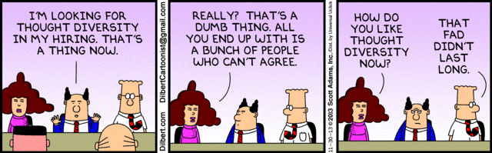

Slide 16
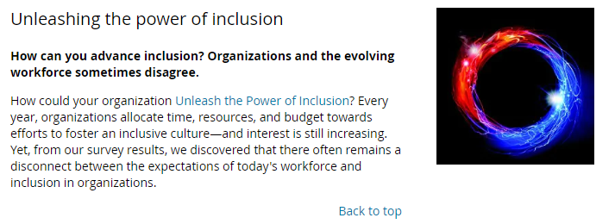
SOURCE: Deloitte Insights

Slide 17
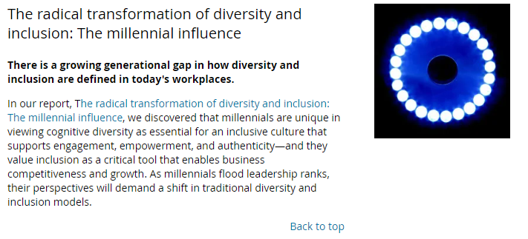
SOURCE: Deloitte Insights

Slide 18
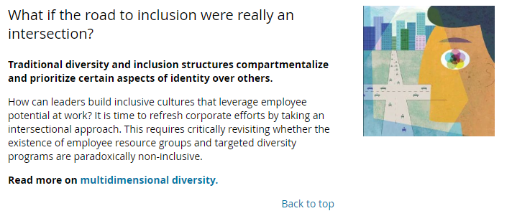
SOURCE: Deloitte Insights

Slide 19
“3 Requirements for a Diverse and Inclusive Culture” GALLUP Workplace
STORY HIGHLIGHTS
Diversity and inclusion require distinct acknowledgement and understanding
However, diversity and inclusion are interrelated
There are three key components to cultivating a diverse and inclusive workplace
SOURCE:
https://www.gallup.com/workplace/242138/requirements-diverse-inclusive-culture.aspx

Slide 20
Diversity
“Diversity represents the full spectrum of human demographic differences -- race, religion, gender, sexual orientation, age, socio-economic status or physical disability. A lot of companies consider lifestyles, personality characteristics, perspectives, opinions, family composition, education level or tenure elements of diversity, too.”

Slide 21
Inclusion
“Inclusion has to be understood as very different from diversity because simply having a wide roster of demographic characteristics won't make a difference to an organization's bottom line unless the people who fall into any one demographic feel welcomed. Inclusion refers to a cultural and environmental feeling of belonging.”

Slide 22
The 3 Requirements
1. Employees are treated with respect.
A culture of inclusiveness is rooted in respect. Employees must be treated with and treat others with civility and decency.
2. Employees are valued for their strengths.
Effective collaboration, productivity and profitability are, of course, why companies incorporate strengths development as a strategy.
3. Leaders do what is right.
One of the reasons companies have diversity policies to begin with is simply because it's the right thing to do… But for that diversity strategy to promote a culture of inclusion too, leaders have to make their values and intentions clear. Leaders must intentionally create an environment where employees feel they can safely express themselves and where specific concerns can be raised with transparency and confidence.

Slide 23

Globally, the workforce is changing, the workplace is changing, the marketplace is changing.
“When we create organizational diversity, we create a fully stocked toolkit. When we practice inclusion, we become master craftspeople, building structures capable of standing strong, even when, or especially when, the landscape is shifting.”
-The Kaleidoscope Group

Slide 24

Diversity Doesn’t Stick Without Inclusion Harvard Business Review
“Diversity” and “inclusion” are so often lumped together that they’re assumed to be the same thing. But that’s just not the case. In the context of the workplace, diversity equals representation. Without inclusion, however, the crucial connections that attract diverse talent, encourage their participation, foster innovation, and lead to business growth won’t happen. As noted diversity advocate Vernā Myers puts it, “Diversity is being invited to the party. Inclusion is being asked to dance.”
SOURCE: https://hbr.org/2017/02/diversity-doesnt-stick-without-inclusion

Slide 25
OBSERVATIONS FROM YOUR PROFESSOR
CIVIL ENGINEERING LEADERSHIP Professional Engineering Practice Issues

Slide 26
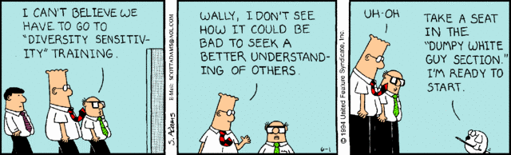

Slide 27
Observations
We live in times where, more than ever, it is necessary that we hear from, and listen to, one another… all of us
Legal aspect… “equal employment opportunity” and “non-discrimination”
Business aspect… seek higher productivity
Cultural aspect… recognize and value uniqueness
Moral aspect… treat persons with respect

Slide 28
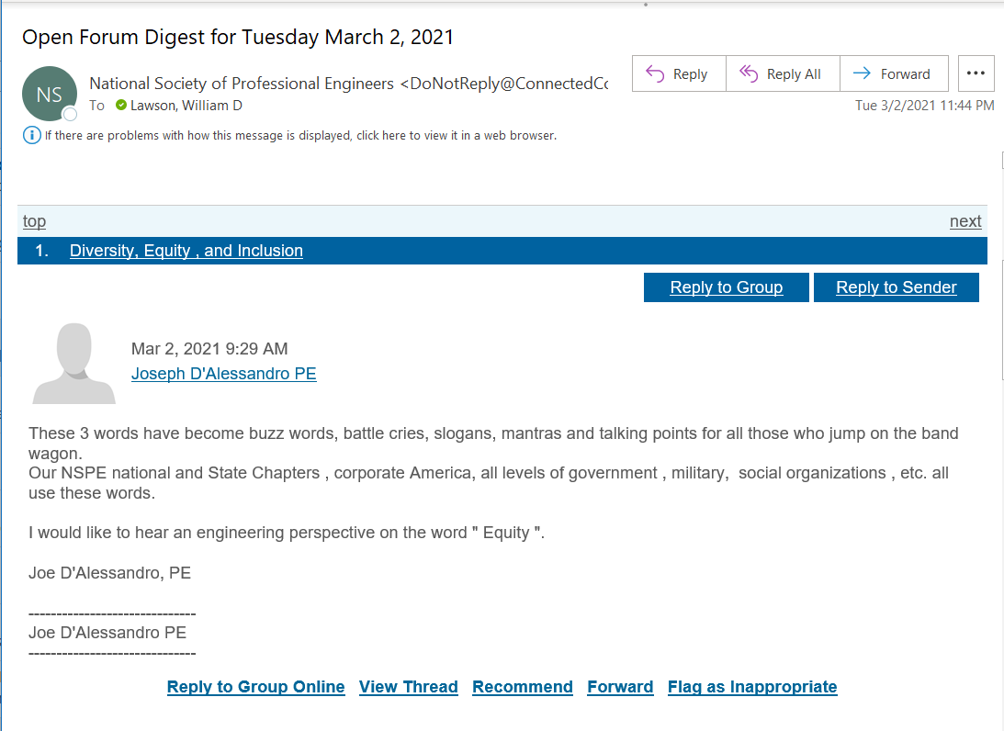

Slide 29
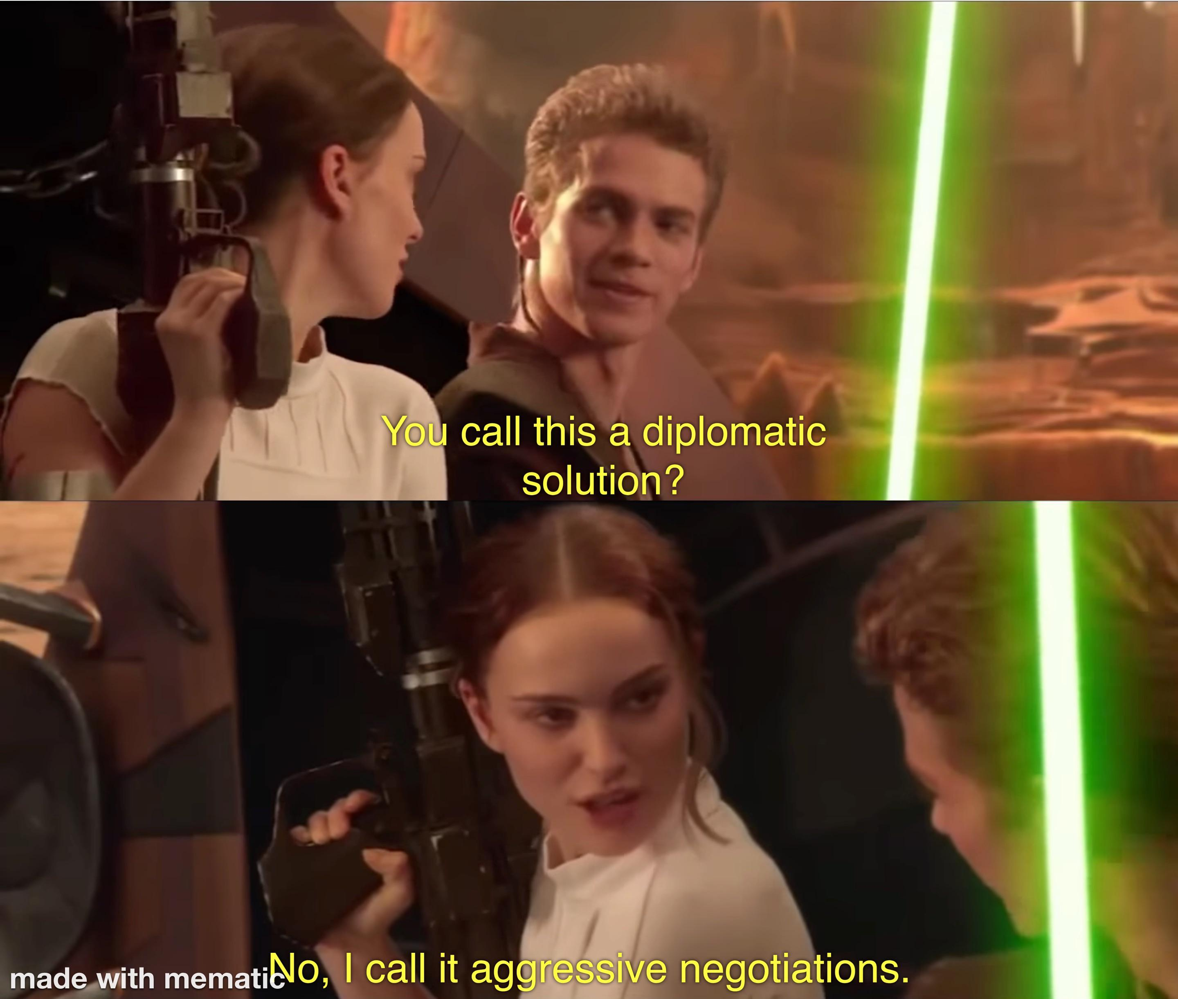

Slide 30
Thank you.
CIVIL ENGINEERING LEADERSHIP Professional Engineering Practice Issues

